Slide 1


Attention Is All You Need
Ashish Vaswani, Noam Shazeer, Niki Parmar, Jakob Uszkoreit, Llion Jones, Aidan N. Gomez, Łukasz Kaiser, Illia Polosukhin
In NIPS 2017 : Advances in Neural Information Processing Systems 30
Aug 1, 2023
Sungmin Yoon
Notes:
Let’s start the review of paper “attention is all you need”. published in 2017

Slide 2
Index
Background
Review of Attention mechanism
Model Architecture
(Experiment & Result)
Discussion
Notes:
Index is as following.

Slide 3
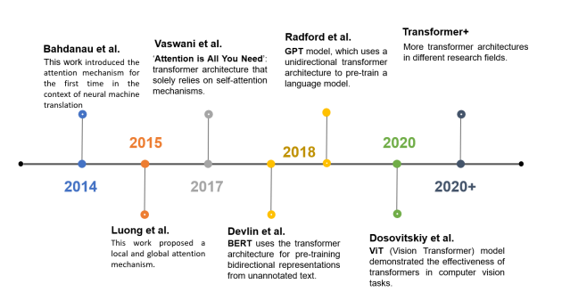
Timeline of Attention mechanism
Reference : Transformer-based models and hardware acceleration analysis in autonomous driving: A survey
Notes:
This is timeline of Attention mechanism. Attention is newly introduced in 2014. and 2017, Google Brain team propose the Transformer, a new simple architecture, which based solely on attention mechanism. From that time, there were explosion of transformer in NLP such as BERT and GPT, and then it have been exploded into many other fields. One example is ViT the vision transformer.

Slide 4
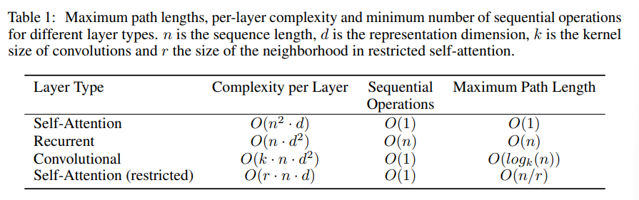
Why Attention?
Long-term dependency problem
One hidden state is not enough
Sequential Computation
Transformer reduce to a constant number of operationw
Notes:
Why we need attention? In other words, What do we solve by attention mechanism?
In the field of sequence data processing, the long term dependency problem has been addressed and improved over time through advancements such as LSTM and GRU. However, these models still faced limitations when dealing with even longer sequences.
Because one hidden state is not enough to capture long-range sequence. It’s nature limitation of the recurrent structure, I think.
Furthermore, the recurrent structure can not process data as parallel, this lead speed slower.
And Attention is proposed a solution of these problems.

Slide 5
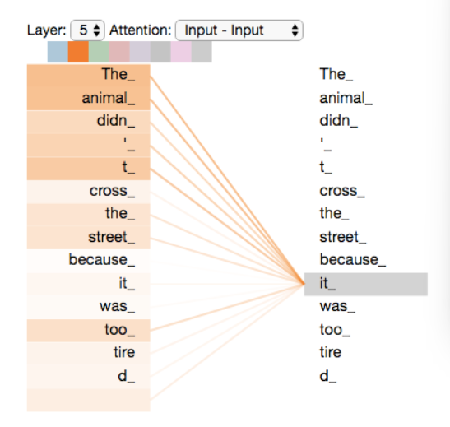
What is Attention?
Attention is an indicator
We can find relevance between each word
Notes:
So, What is attention?
Literally, Attention is an indicator where we pay attention to. the attention algorithm allow the word ‘it’ to be associated with related other words in the different position. As in the right figure, more intense color means greater relevance, so attention help us to look at the word ‘the animal’ when we see the word ‘it’.

Slide 6
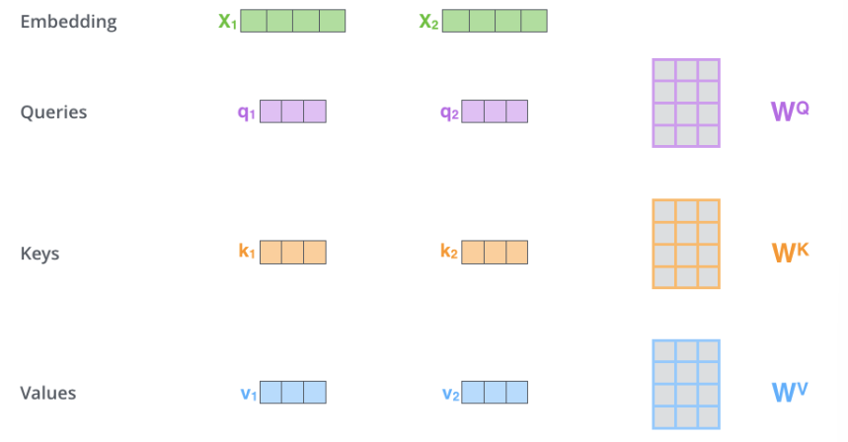
How Attention mechanism works?
1. Create three vectors Q,K,V
2. Calculate with the following formular
Notes:
How the attention mechanism work? Attention mechanism give us scores, which represent how much focus to other parts of the input sequence. By following two steps, we can get an attention score.
First, for each input vectors, make three vectors which are query, key and value. In this paper, input vector is embedding of each word. We can create these three vectors by multiplying the input by three matrices that can be trained.

Slide 7
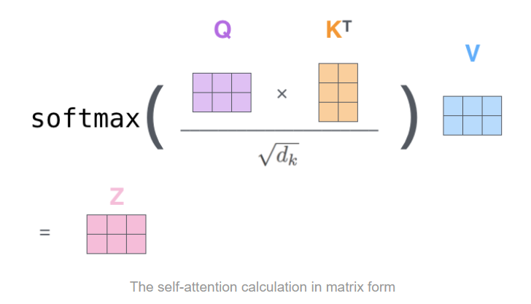
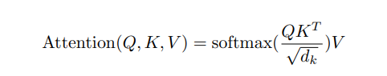
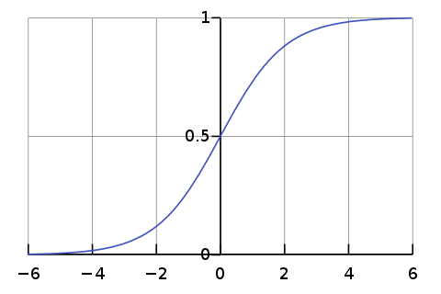
How Attention mechanism works?
1. Create three vectors Q,K,V
2. Calculate with the following formular
Sigmoid(1d softmax)
Vanishing!
Notes:
And then, calculate with the following formular. The most important part of this calculation is inner product of query and key vector of respective word we’re scoring. Which means, how much closer these two vector in the vector space using cosine similarity.
And then put into the softmax function, so the score is normalized they’re all positive and summation is 1. and there is a scaling factor square root dk, which is dimension of key vector, which prevent gradient vanishing. You can see the sigmoid graph in the right and down side, the derivative becomes smaller when the value grows.
Finally, multiply each value vector to adjust the attention score.

Slide 8
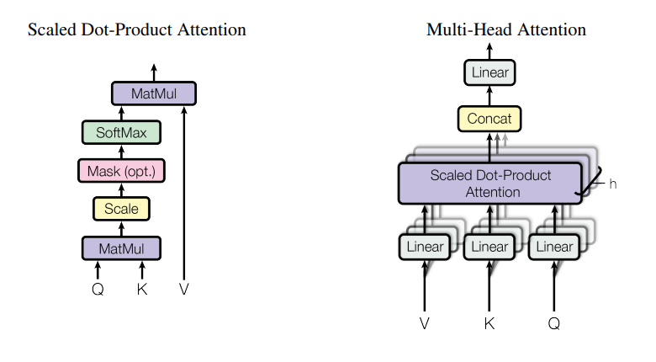
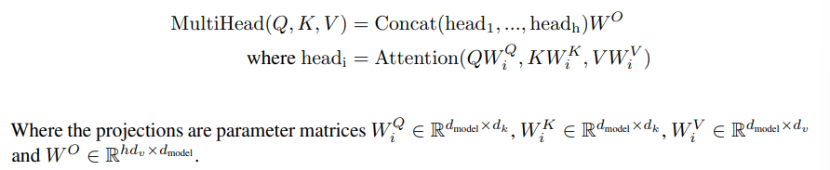
Add a Parallelism
Notes:
And there is some trick the researcher use.
If we consider one scaled Dot-Product attention as one head, adding multiple heads allows us to achieve parallelism. Researchers use eight heads, so the number of output is also eight. So we concat the output.

Slide 9
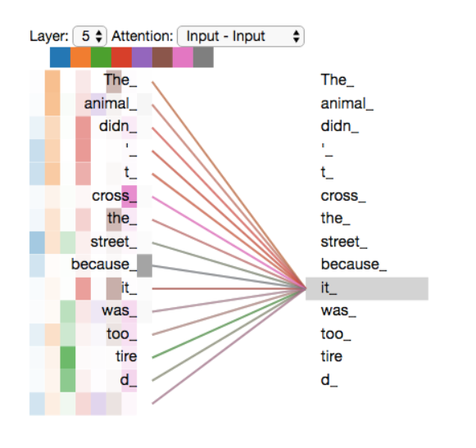
Add a Parallelism
Notes:
Like this. Using multiple head allow us not only parallelism, also give us representation performance.

Slide 10
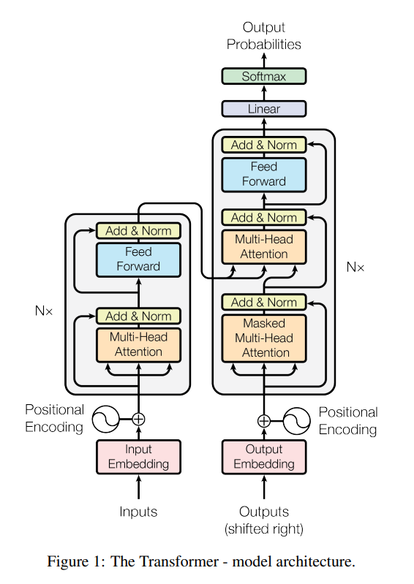
Model Architecture
Decoder
Encoder-decoder structure
Stack size N = 6
Encoder
Notes:
Now, let’s take a look at the architecture of transformer.
Transformer is kind of an Encoder-decoder structure. As we can see in the right figure, Both encoder and decoder are composed of a stack of N identical layers.

Slide 11
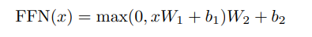
Model Architecture
Encoder(2-sub layers)
Multi-head Self-Attention
Feed Forward Network(FFN) – position wise
Residual connection
Layer normalization
Notes:
Encoder layer is broken down into two-sub layers.
One is a self-attention layer, we discussed earlier, the other one is feed forward network. Which is fully connected and point-wise.
There is residual connection around each of two-sub layers, and followed by layer normalization.

Slide 12
Model Architecture
Decoder(3-sub layers)
Modified self-attention(Masking)
Encoder-decoder attention layer
FFN
Notes:
Decoder has 3-sub layers.
Encoder-decoder attention layer is inserted between two sub-layer which is same of encoder’s. but one thing is different in self-attention layer in decoder, which is masking. Masking is –inf, which converted zero when passing through the softmax. So It can maintain auto –regressive property

Slide 13
Self attention vs Cross attention
Where the Key/Value come from?
Notes:
Here’s a good animation illustrating the difference between self-attention and cross-attention:
In self-attention, the query, key, and value are all taken from the same layer. On the other hand, in the cross-attention layer like encoder-decoder attention layer in the decoder, the query is taken from the previous decoder layer, while the key and value from the encoder’s outputs.
This allows the decoder to attend to relevant information in the encoder's output and align the generated output with the input sequence.

Slide 14
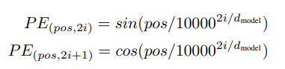
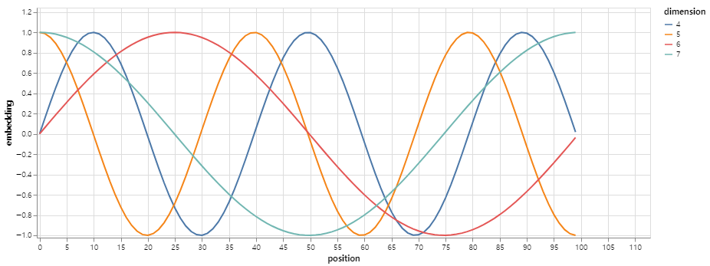
Positional Encoding
Example.
I walk my dog every day
vs
every day I walk my dog
Notes:
Instead of using RNN or CNN, transformer use positional encoding. Because we take input as parallel, we lose all the sequential information. Researchers use trigonometric function to represent relative positional information.
The importance of relative positional information can be easily understood through the following example.
I walk my dog every day vs every day I walk my dog
Using relative positional information, we can consider these two sentence with different order but the same meaning as equivalent.

Slide 15
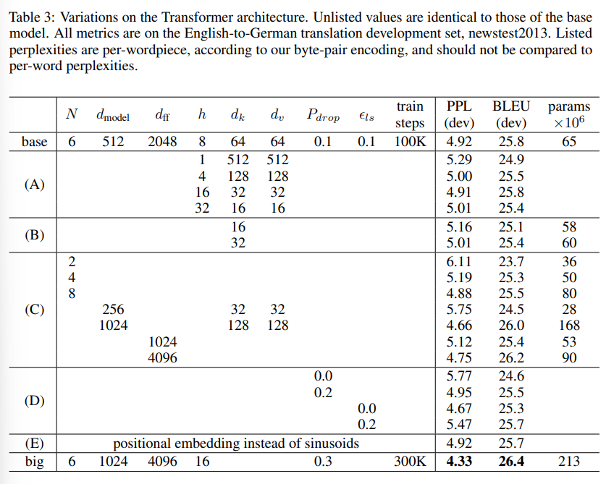
Result with various hyper-parameters
Notes:
I’ll skip the results

Slide 16
Discussion
Good
Detailed and qualified result
Transferable -> more brain-like
Explanation
Bad
Memory cost

